Slide 1
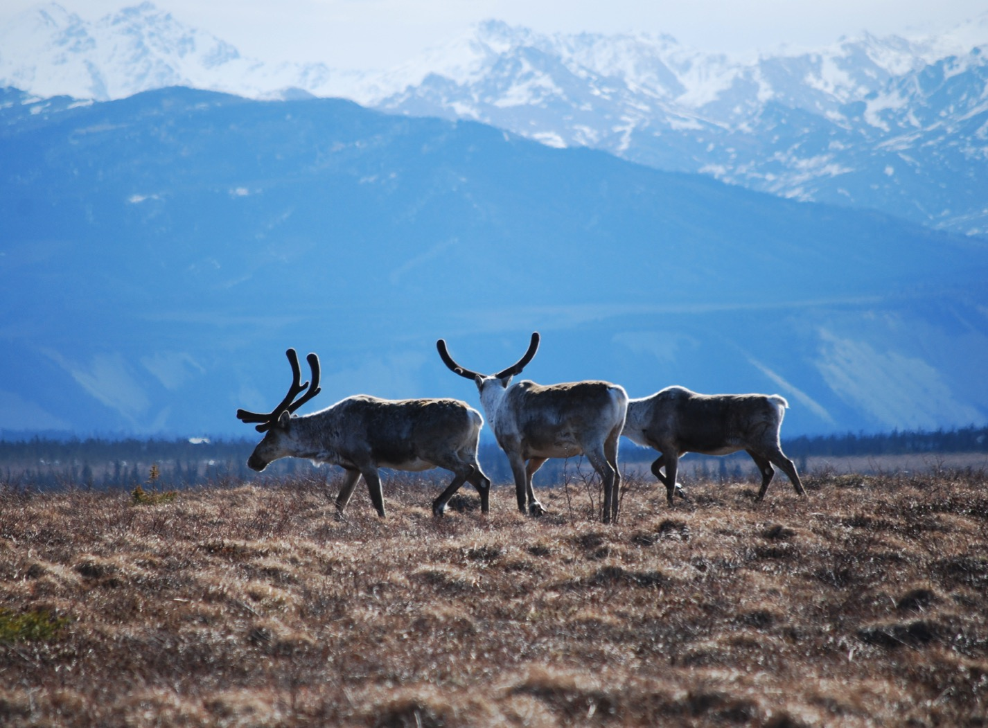
Arctic Boreal Vulnerability Experiment (ABoVE)
2017 ABoVE Airborne Campaign
9 July 2017 (DOY 190)
AVIRIS-NG: Barrow – Atqasuk
Charles Miller, Deputy Science Lead
Jet Propulsion Laboratory, California Institute of Technology
and the ABoVE Science Team For Hank Margolis, Eric Kasichke, Bruce Tagg
NASA HQ
2017

Slide 2
9 July 2017/DOY 190 Barrow – Atqasuk
Daily Status:
AVIRIS-NG / N53W ABoVE CAMPAIGN (CANADA / ALASKA)
REPORT DATE: 8 July 2018
Current Status of Aircraft: Yellow
Current Status of AVIRIS: GREEN
Current Deployment Location: Fairbanks AK (PAFA)
Crew: Rogers, Heidt, Nolte, Sullivan
Science Coordinator: A Thorpe
Science Lead: C Miller
Project Managers: M Eastwood, I McCubbin
Instrument PI: R Green
Notes:
Aircraft avionics package continues to have intermittent loss of heading problems

Slide 3
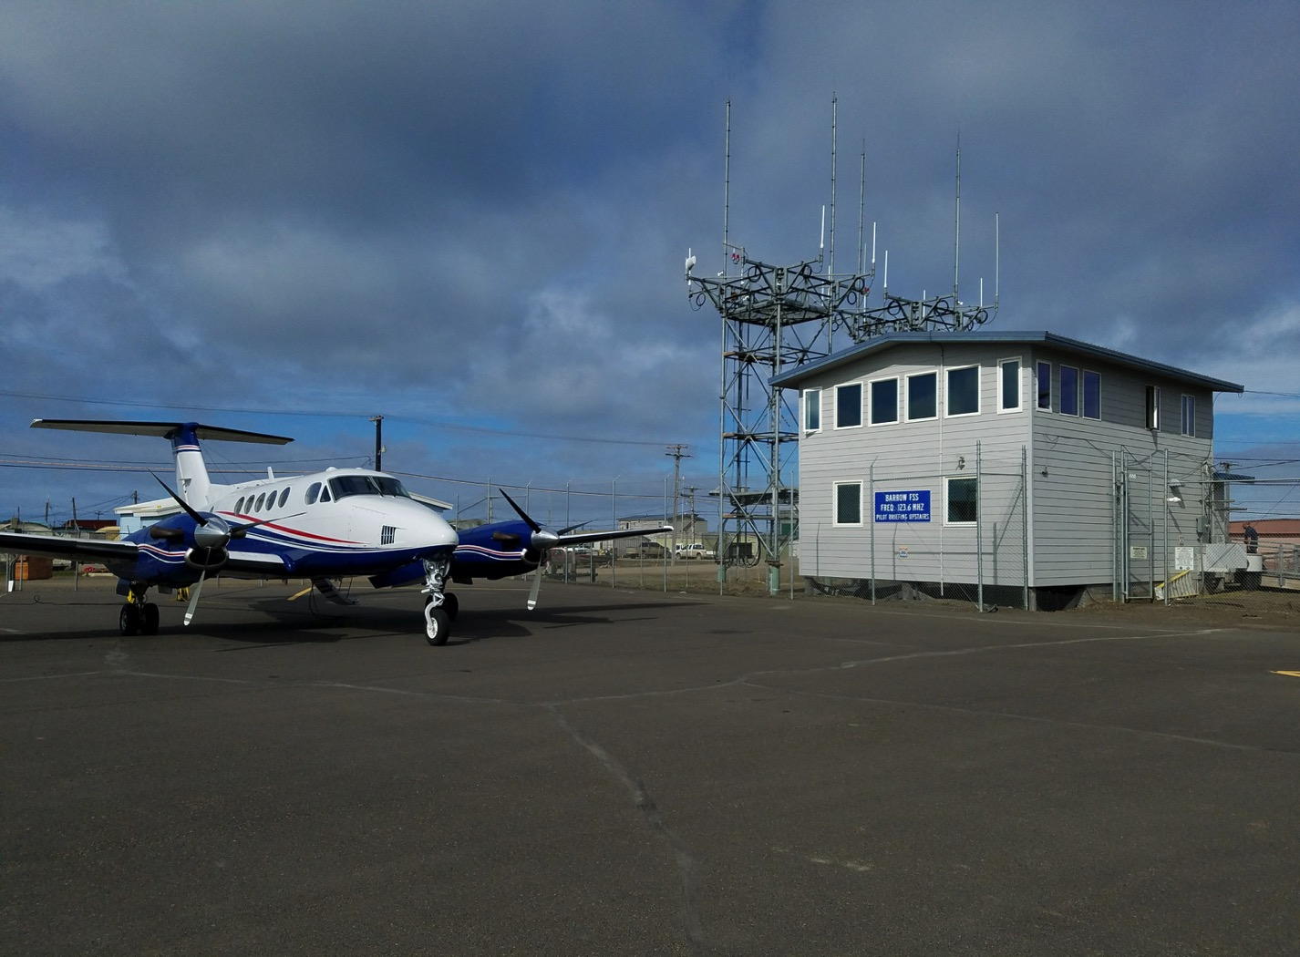
9 July 2017/DOY 190 Barrow – Atqasuk
AVIRIS / N53W at Barrow
Stevens Village
Beaver
AVIRS and CFIS Teams at Deadhorse Airport (PASC)

Slide 4
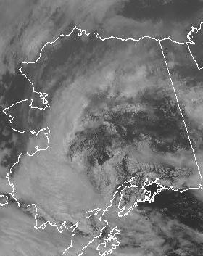
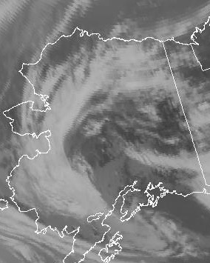
9 July 2017/DOY 190 Barrow – Atqasuk
GOES West Vis 2200Z
GOES West IR 2200Z
Notes:
Clear to partly cloudy in the Barrow – Atqasuk area of the western North Slope

Slide 5
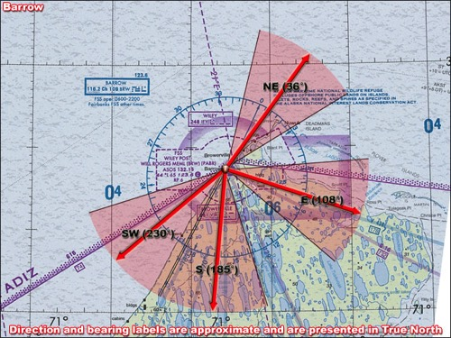
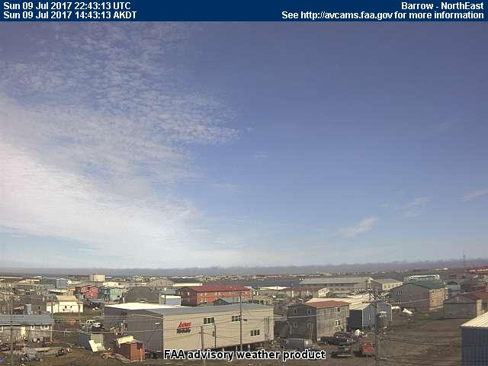
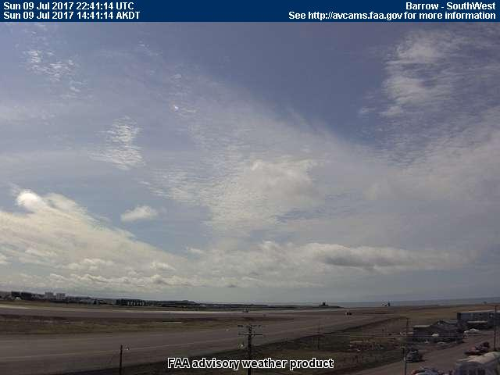
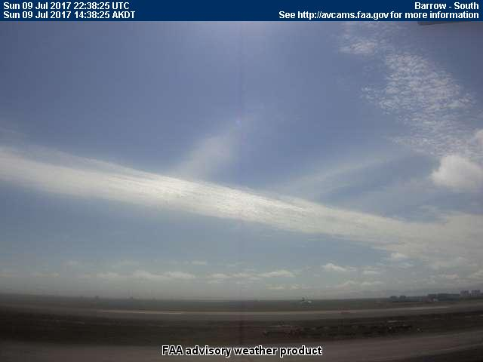
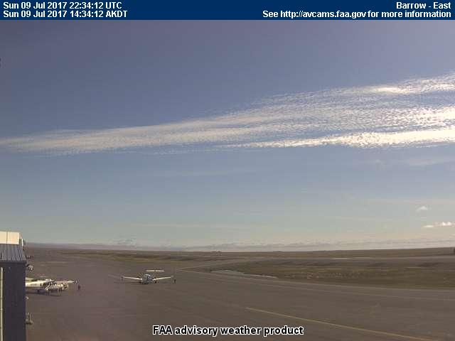
9 July 2017/DOY 190 Barrow – Atqasuk
Barrow (BRW) (PABR)
Northeast
Southwest
South
East
Notes:
AVCAM sky pictures from Barrow show a mix of clear sky and thin clouds
See http://avcams.faa.gov/ for an interactive map of Alaska aviation cameras

Slide 6
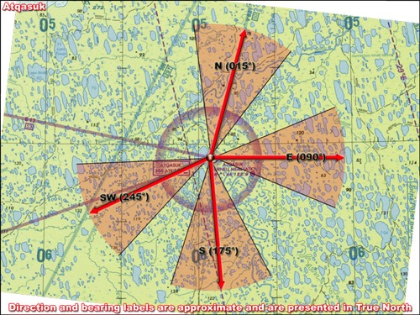
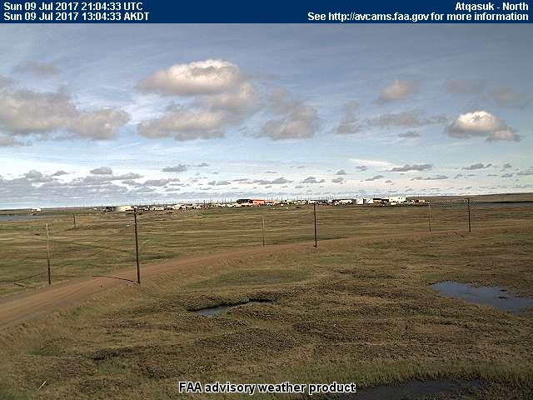
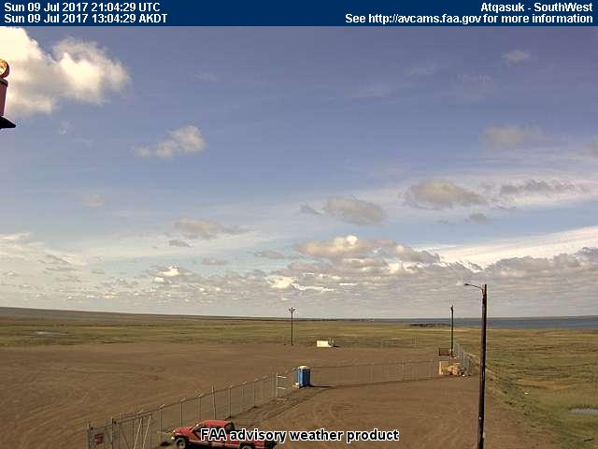
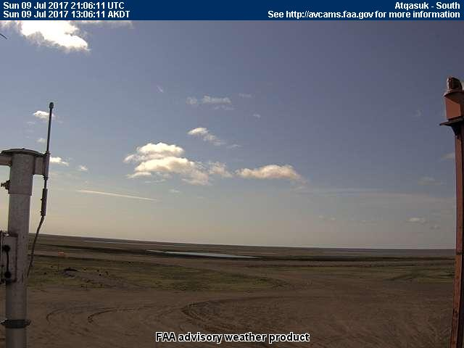
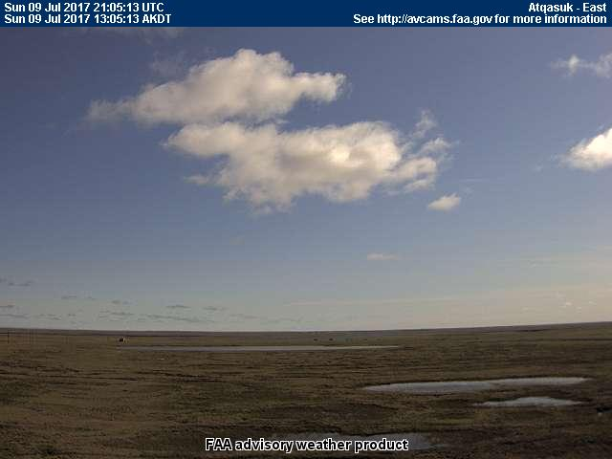
9 July 2017/DOY 190 Barrow – Atqasuk
Atqasuk (ATK) (PATQ)
North
Southwest
South
East
Notes:
AVCAM sky pictures fromAtqasuk show clear views between intermittent clouds
See http://avcams.faa.gov/ for an interactive map of Alaska aviation cameras

Slide 7
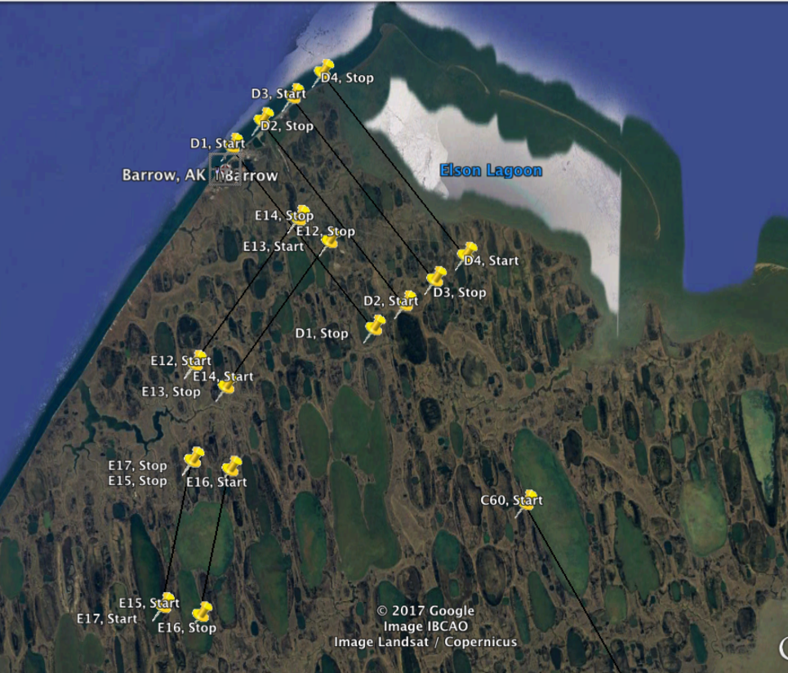
9 July 2017/DOY 190 Barrow – Atqasuk
Planned Lines & Acquisition Segments
E13/303
E14/304
D4/225
D3/224
D2/223
D1/222
E16/306
E17/307
C60/217
Planned flight lines & acquisition segments

Slide 8
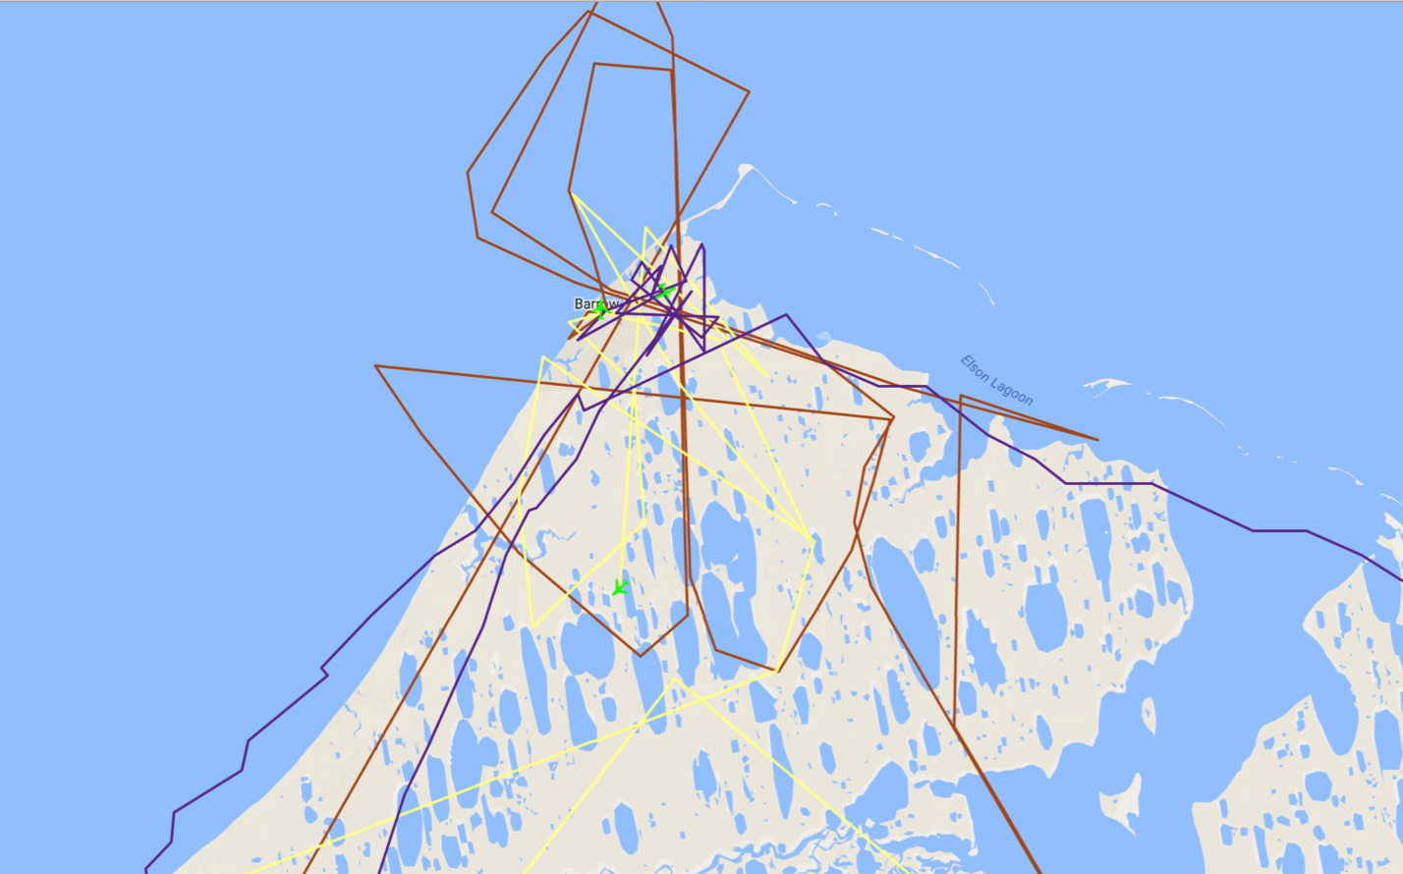
9 July 2017/DOY 190 Barrow – Atqasuk
Coordinated Flights At Barrow
As-flown Lines
AVIRIS/N53W
LVIS/N44U
CFIS/N331AR
ArctiC-C/N617DH
Notes:
Unprecedented opportunity to evaluate vegetation structure, function, and composition for the tundra ecosystems in and around barrow from same day measurements by AVIRIS (composition, chemistry and vegetation type), CFIS (photosynthetic activity/productivity), and LVIS (structure)

Slide 9
9 July 2017/DOY 190 Barrow – Atqasuk
AVIRIS-NG Quick-look products
https://avirisng.jpl.nasa.gov/cgi/flights.cgi?step=view_flightlog&flight_id=ang20170709t
A. Line E20, Track Air #310, Run ID 191907: Coffee Lake/Atqasuk
B. Line E19, Track Air #309, Run ID 192500: Coffee Lake/Atqasuk
Winston Olson-Duvall, JPL
A
B
A. Atqasuk is seen in the left had edge of this image
B. Update

Slide 10
9 July 2017/DOY 190 Barrow – Atqasuk
AVIRIS-NG Quick-look products
https://avirisng.jpl.nasa.gov/cgi/flights.cgi?step=view_flightlog&flight_id=ang20170709t
A. Line C55, Track Air #212, Run ID 193321: ATQ, flux tower, CALM
B. Bonus Line, Run ID 201525: Start 70.987 N, 156.695 W
Winston Olson-Duvall, JPL
A
B
A. This image covers the Atqasuk CALM site and CO2/CH4 flux tower
B. Lakes, drained lakebeds and ponds near Atqasuk

Slide 11
9 July 2017/DOY 190 Barrow – Atqasuk
AVIRIS-NG Quick-look products
https://avirisng.jpl.nasa.gov/cgi/flights.cgi?step=view_flightlog&flight_id=ang20170709t
A. Line C60, Track Air #217, Run ID 195215: Lake Tusikvoak (SE of Barrow)
B. Line C61, Track Air #218, Run ID 202038: Atqasuk → Arctic Ocean coast
Winston Olson-Duvall, JPL
A
B
A. Patchy clouds flowat over Lake Tusikvoak near Barrow
B. Excessive cloud interference

Slide 12
9 July 2017/DOY 190 Barrow – Atqasuk
AVIRIS-NG Quick-look products
https://avirisng.jpl.nasa.gov/cgi/flights.cgi?step=view_flightlog&flight_id=ang20170709t
A. Line D1, Track Air #222, Run ID 203930: Barrow Grid
B. Line D1, Track Air #222, Run ID 224222: Barrow Grid (repeat)
Winston Olson-Duvall, JPL
A
B
A. Excessive cloud interference near coast
B. Barrow airport and town are seen in the left-hand edge of the image

Slide 13
9 July 2017/DOY 190 Barrow – Atqasuk
AVIRIS-NG Quick-look products
https://avirisng.jpl.nasa.gov/cgi/flights.cgi?step=view_flightlog&flight_id=ang20170709t
A. Line D2, Track Air #223, Run ID 224839: Barrow Grid
B. Line D3, Track Air #224, Run ID 225457: Barrow Grid
Winston Olson-Duvall, JPL
A
B
A. Barrow town seen in the left-hand edge of the image, dominated by drained lakebeds
B. Rippling waves of low clouds obscure this image

Slide 14
9 July 2017/DOY 190 Barrow – Atqasuk
AVIRIS-NG Quick-look products
https://avirisng.jpl.nasa.gov/cgi/flights.cgi?step=view_flightlog&flight_id=ang20170709t
A. Line E13, Track Air #303, Run ID 232308: Pipeline Lake
B. Line E14, Track Air #304, Run ID 230326: Pipeline Lake
Winston Olson-Duvall, JPL
A
B
A. & B. Ikroavik Lake (Pipeline Lake), a large methane ebullition source

Slide 15
9 July 2017/DOY 190 Barrow – Atqasuk
AVIRIS-NG Quick-look products
https://avirisng.jpl.nasa.gov/cgi/flights.cgi?step=view_flightlog&flight_id=ang20170709t
A. Line E16, Track Air #306, Run ID 231636: Sukok Lake
B. Line E17, Track Air #307, Run ID 231121: Sukok Lake
Winston Olson-Duvall, JPL
A
B
A.& B. Brilliant green swirling lake biota in Sukok Lake, one of the largest methane ebullition sites yet identified in Alaska

Slide 16
9 July 2017/DOY 190 Barrow – Atqasuk
AVIRIS-NG Quick-look products
https://avirisng.jpl.nasa.gov/cgi/flights.cgi?step=view_flightlog&flight_id=ang20170709t
A. Line D4, Track Air #225, Run ID 233000: Barrow Grid
B. Bonus Line, Run ID 233755: Barrow area coastline
Winston Olson-Duvall, JPL
A
B
A. Excessive cloud interference
B. Opportunity for near-shore ocean retrievals

Slide 17
9 July 2017/DOY 190 Barrow – Atqasuk
AVIRIS-NG Quick-look products
https://avirisng.jpl.nasa.gov/cgi/flights.cgi?step=view_flightlog&flight_id=ang20170709t
A. Line C61, Track Air #218, Run ID 234558: Atqasuk → Arctic Ocean coast
B. Line C55, Track Air #212, Run ID 235600: ATQ flux tower, CALM site
Winston Olson-Duvall, JPL
A
B
A. Excessive cloud interference near the coast
B. Atqasuk village and airfield clearly imaged

Slide 18
9 July 2017/DOY 190 Barrow – Atqasuk
AVIRIS-NG Quick-look products
https://avirisng.jpl.nasa.gov/cgi/flights.cgi?step=view_flightlog&flight_id=ang20170710t
A. Bonus Line, Run ID 000507: Start 70.06 N, 156.95 W, near Line C59
Winston Olson-Duvall, JPL
A
B
A. Some cloud interference near the end of this line

Slide 19
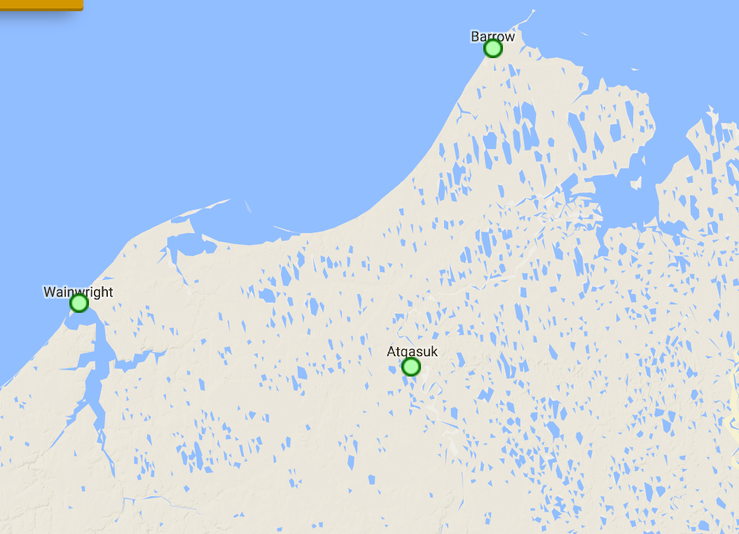
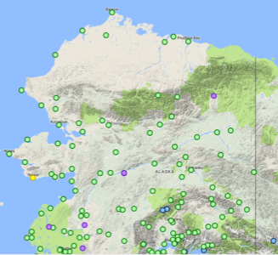
Barrow Area FAA Webcamera Locations

Slide 20
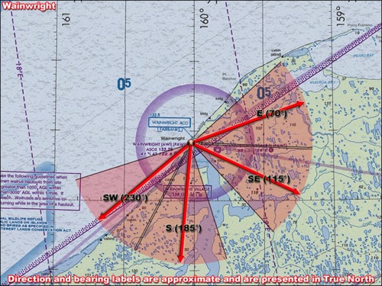
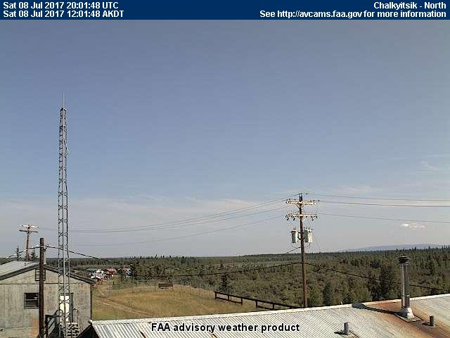
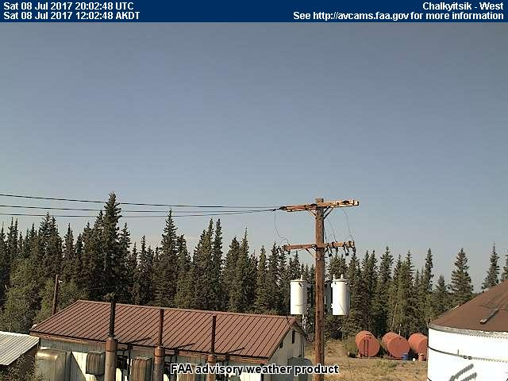
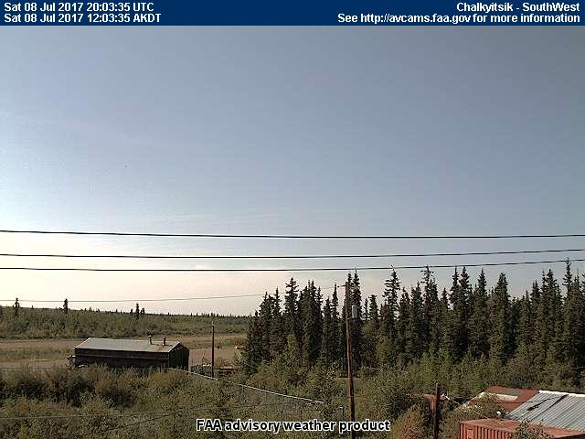
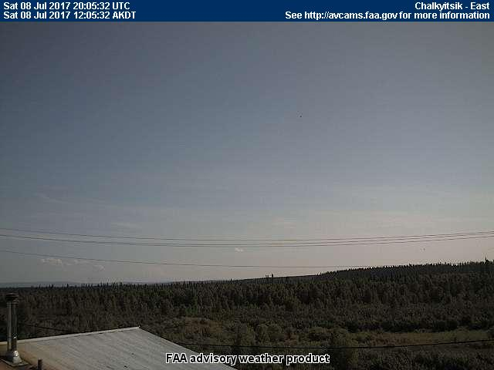
9 July 2017/DOY 190 Barrow – Atqasuk
Wainwright (AWI) (PAWI, west of Atqasuk)
NORTH
East
Southwest
South
Southeast
Notes:
AVCAM sky pictures from the Chalkyitsik air strip at 1201 AKDT/2001UTC showing extreme clear conditions with some high clouds on the horizon. No indication of smoke or aerosol from fires to the east
See http://avcams.faa.gov/ for an interactive map of Alaska aviation cameras

